Slide 1

PBCST504 – MICROCONTROLLERS
MICRO PROJECT
Zeroth Review

Slide 2
Title:- Distributed IoT Security System for Covert Tracker Detection
Group No: 3
Members: Hrisheekesh P M
Hareesh P Das Ebin Baby
Addison Biju
Alan C O
Project Coordinator:
Ms.Sagna L T
Asst. Prof. CSE(CY)

Slide 3
DEPARTMENT OF COMPUTER SCIENCE & ENGINEERING
(Cyber Security)
Vision of the Department
To be a globally recognized centre of excellence in Cyber Security education, research and innovation by nurturing ethical professionals , fostering technological advancement through responsible practice and contributing to a secure and sustainable digital society.

Slide 4
DEPARTMENT OF COMPUTER SCIENCE & ENGINEERING
(Cyber Security)
Mission of the Department
M1: Excellence in Education : To provide outcome-based and industry-oriented education by integrating core computer science principles with advanced cybersecurity technologies and practices.
M2: Ethics and Professional Responsibility : To cultivate ethical values, integrity, social responsibility, and secure computing practices for protecting digital assets and strengthening cyber trust.
M3: Research, Innovation, and Entrepreneurship : To promote research, innovation, and entrepreneurial thinking for developing sustainable solutions to emerging cybersecurity challenges.
M4: Holistic and Global Development : To enhance leadership, teamwork, lifelong learning, and global competence through industry collaboration, interdisciplinary activities, and community engagement.

Slide 5
Programme Educational Objectives (PEOs)
PEO 1: Graduates will apply strong foundations in computer science and cybersecurity to design, develop, and manage secure and reliable computing systems for industry and society.
PEO 2: Graduates will pursue successful careers as professionals, innovators or entrepreneurs engaged in technology development, deployment or engineering system implementation in industry and society and contribute to the economic growth of the country.
PEO 3: Graduates will demonstrate ethical responsibility, leadership, teamwork, and effective communication while adapting to evolving global technological environments through lifelong learning.

Slide 6
Programme Outcomes
Engineering Graduates will be able to:
1. Engineering knowledge: Apply the knowledge of mathematics, science, engineering fundamentals, and an engineering specialization to the solution of complex engineering problems.
2. Problem analysis: Identify, formulate, review research literature, and analyze complex engineering problems reaching substantiated conclusions using first principles of mathematics, natural sciences, and engineering sciences.
3. Design/development of solutions: Design solutions for complex engineering problems and design system components or processes that meet the specified needs with appropriate consideration for the public health and safety, and the cultural, societal, and environmental considerations.
4. Conduct investigations of complex problems: Use research-based knowledge and research methods including design of experiments, analysis and interpretation of data, and synthesis of the information to provide valid conclusions.
5. Modern tool usage: Create, select, and apply appropriate techniques, resources, and modern engineering and IT tools including prediction and modeling to complex engineering activities with an understanding of the limitations.

Slide 7
6. The engineer and society: Apply reasoning informed by the contextual knowledge to assess societal, health, safety, legal and cultural issues and the consequent responsibilities relevant to the professional engineering practice.
7. Environment and sustainability: Understand the impact of the professional engineering solutions in societal and environmental contexts, and demonstrate the knowledge of, and need for sustainable development.
8. Ethics: Apply ethical principles and commit to professional ethics and responsibilities and norms of the engineering practice.
9. Individual and team work: Function effectively as an individual, and as a member or leader in diverse teams, and in multidisciplinary settings.
10. Communication: Communicate effectively on complex engineering activities with the engineering community and with society at large, such as, being able to comprehend and write effective reports and design documentation, make effective presentations, and give and receive clear instructions.
11. Project management and finance: Demonstrate knowledge and understanding of the engineering and management principles and apply these to one’s own work, as a member and leader in a team, to manage projects and in multidisciplinary environments. 12. Life-long learning: Recognize the need for, and have the preparation and ability to engage in independent and life-long learning in the broadest context of technological change.

Slide 8
Programme Specific Outcomes (PSOs)
On the completion of Computer Science & Engineering program, the students will possess:
PSO 1: Apply cyber security principles to mitigate cyber risk and analyze security requirements of an organization.
PSO 2: Develop and deploy secure software and infrastructure using modern tools and industry standards.
PSO 3: Uphold ethical, legal, and societal responsibilities while protecting privacy, data, and digital assets.

Slide 9
CONTENTS
Motivation
Introduction
Problem Statement
Proposed Method
Basic Block Diagram
Conclusion
References

Slide 10
Motivation
Growing use of Bluetooth-enabled devices has increased privacy and security risks.
Hidden BLE trackers can be misused for unauthorized tracking and surveillance.
Existing detection solutions are often expensive or limited to specific platforms.
Users need a portable, affordable, and real-time tracker detection system.
BLE Guard provides continuous monitoring and instant threat identification.
The project promotes personal safety by helping users detect suspicious BLE devices.

Slide 11
Introduction
BLE Guard is an ESP32-based Bluetooth Low Energy (BLE) tracking detector.
It scans nearby BLE devices and identifies potential tracking threats.
The system detects Apple Find My devices and other BLE trackers.
It estimates device location using GPS and Wi-Fi information.
Detected data is uploaded securely to a web dashboard for monitoring.
The solution combines hardware, firmware, and a secure web application.

Slide 12
Problem Statement
Bluetooth trackers can be used without the owner's knowledge.
Existing detection methods are limited to certain mobile operating systems.
Many users are unaware of nearby tracking devices.
Commercial solutions are often expensive and lack centralized monitoring.
Detecting persistent tracking behavior is difficult using conventional methods.
A low-cost, cross-platform detection system is required.

Slide 13
Proposed Method
ESP32 continuously scans for nearby BLE advertisements.
Devices are identified based on MAC address, vendor, and device type.
Behavioural analysis calculates a threat score (0–100) for each device.
GPS and Wi-Fi provide approximate location information.
Detection data is securely transmitted to a PHP-MySQL web server.
The dashboard displays live alerts, history, whitelist management, and reports.

Slide 14
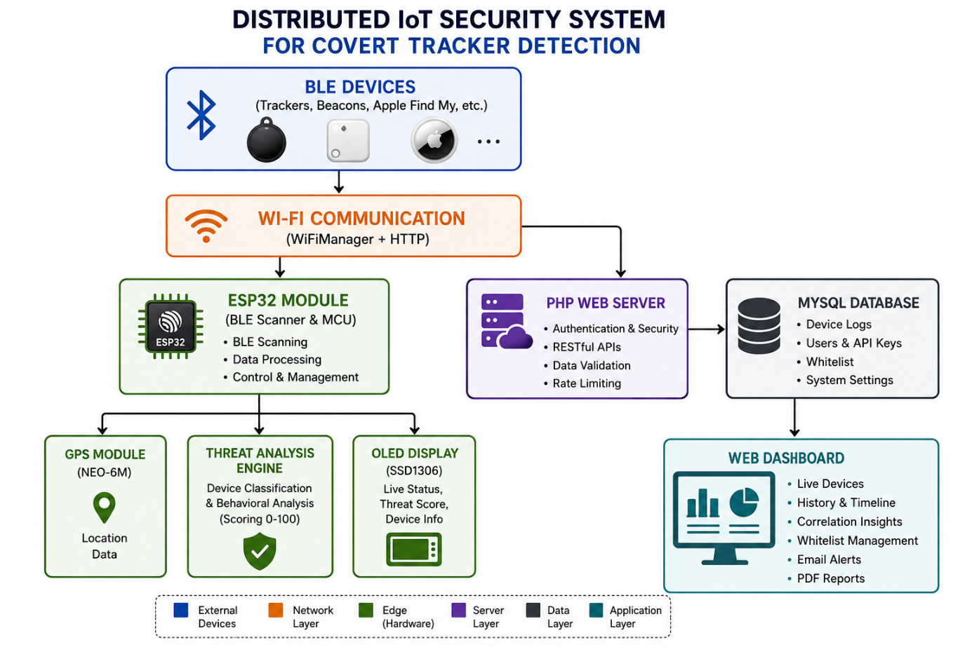
Basic Block Diagram

Slide 15
Conclusion
BLE Guard provides an affordable solution for detecting BLE tracking devices.
The system combines real-time scanning with intelligent threat analysis.
Secure cloud synchronization enables remote monitoring and data storage.
The web dashboard simplifies visualization and management of detected devices.
The modular design allows future enhancements and feature expansion.
BLE Guard improves user awareness and strengthens personal privacy.

Slide 16
References
ESP32 Technical Reference Manual – Espressif Systems
Bluetooth Core Specification v5.x – Bluetooth SIG
ESP-IDF Documentation – Espressif Systems
NEO-6M GPS Module Datasheet – u-blox
SSD1306 OLED Display Documentation
PHP Official Documentation and MySQL Documentation

